Slide 1
Hybris Commerce Accelerator
Module - 21

Slide 2
Contents
Overview
Benefits
Features
Future Vision

Slide 3
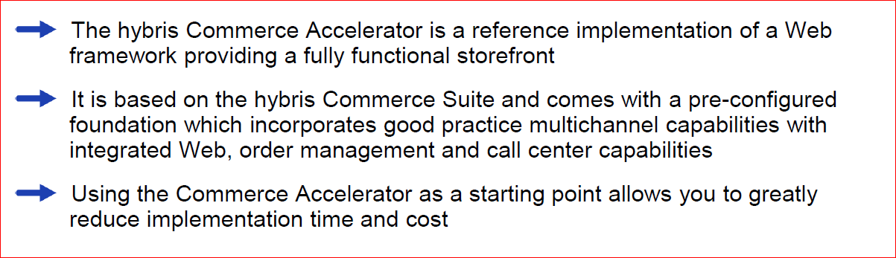
The hybris Commerce Accelerator

Slide 4
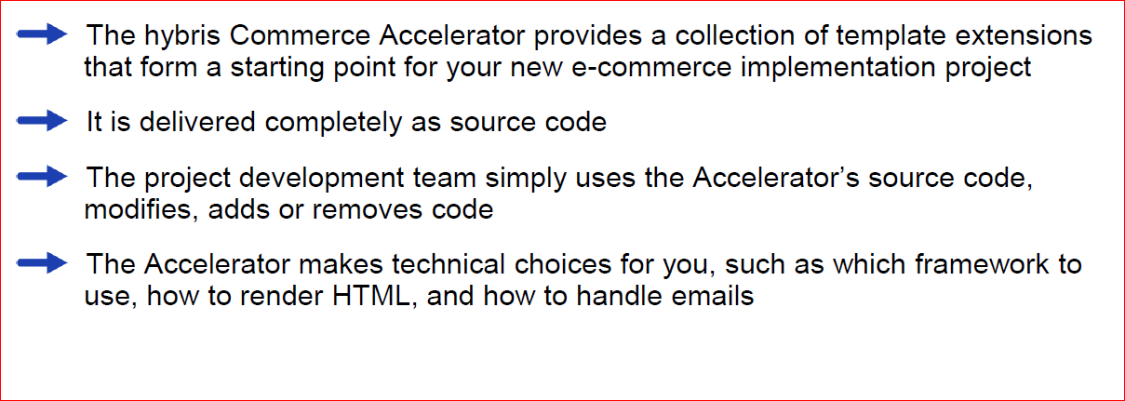
Purpose

Slide 5
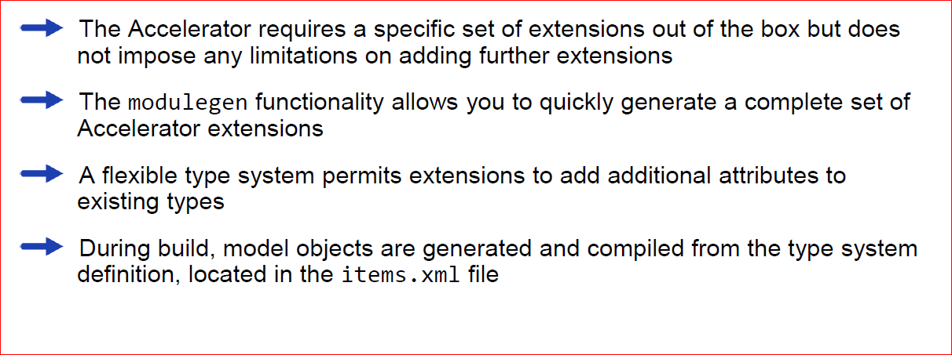
Extensions

Slide 6
Contents
Overview
Benefits
Features
Future Vision

Slide 7
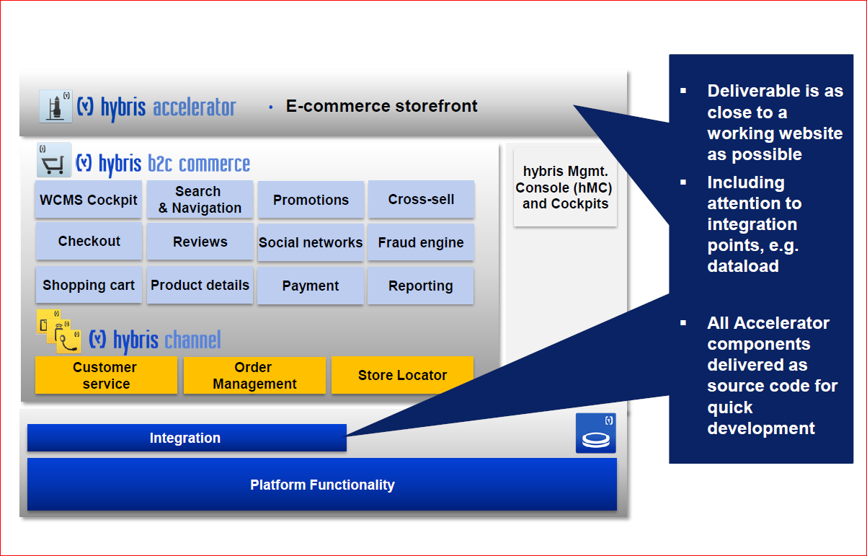
A Commerce platform, out of the box !

Slide 8
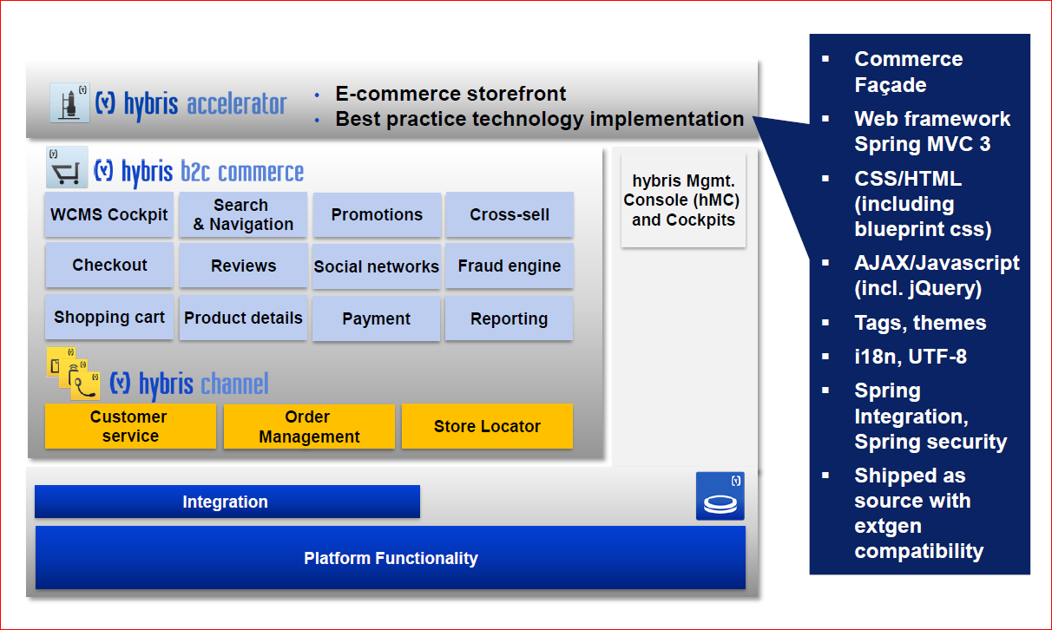
Benefits – Best practice technology implementation

Slide 9
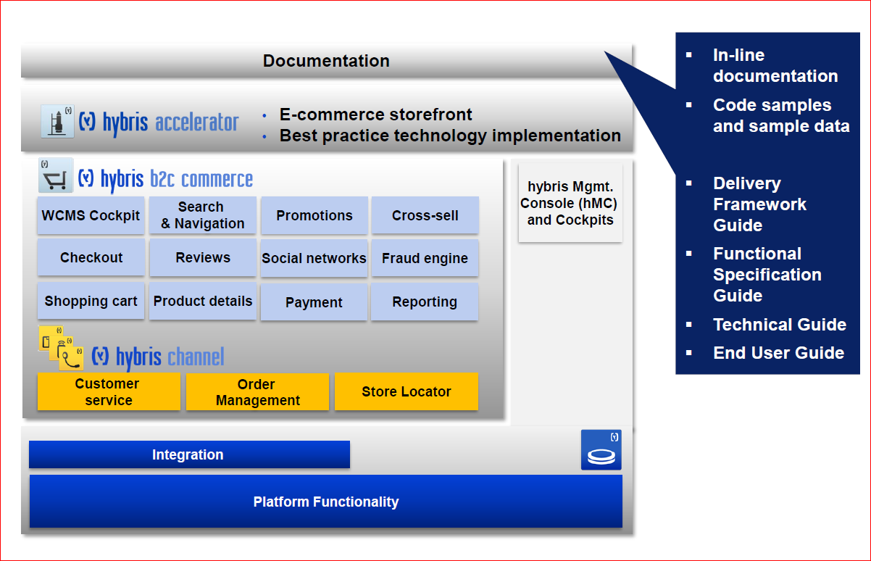
Benefits – Extensive documentation

Slide 10
Contents
Overview
Benefits
Features
Future Vision

Slide 11
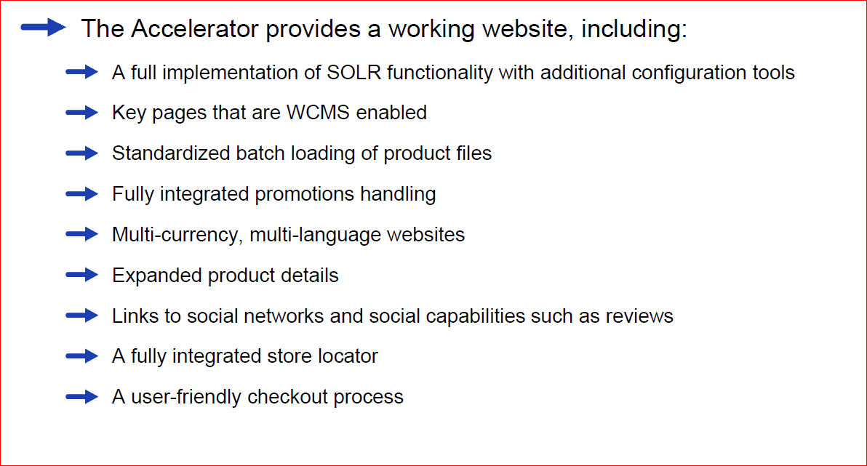
Commerce Accelerator Features

Slide 12
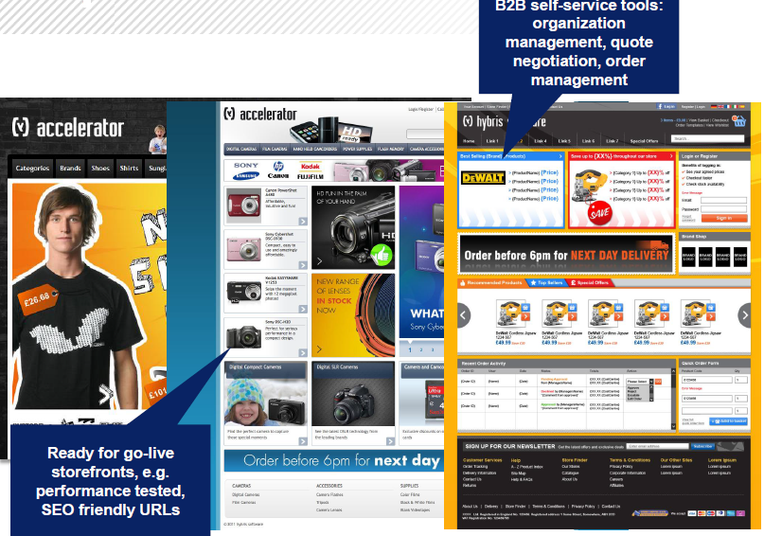
Currently three storefronts Out Of The Box

Slide 13
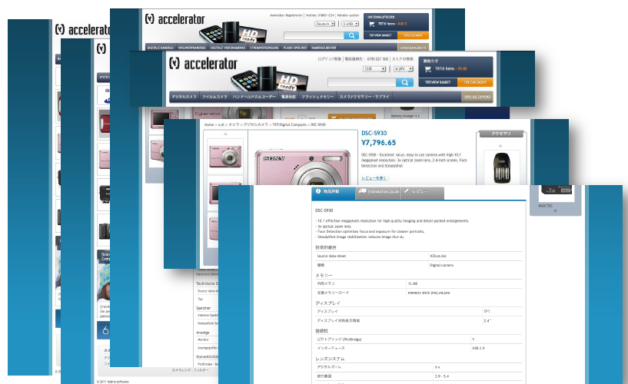
Multiple sites, languages, currencies

Slide 14
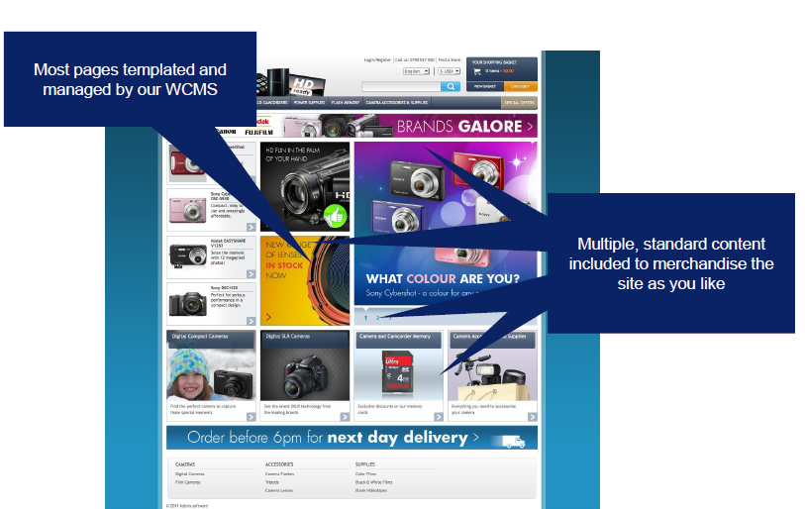
Built with business users in mind

Slide 15
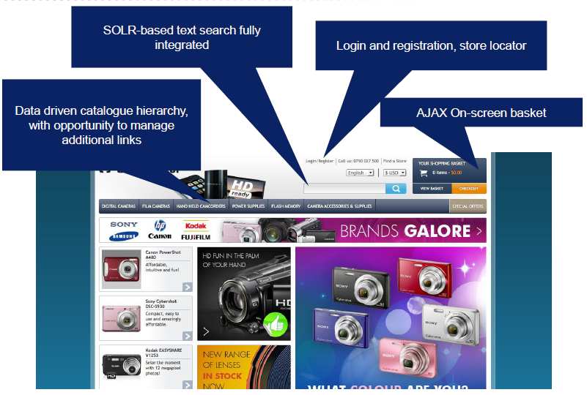
Provides typical eCommerce functionality

Slide 16
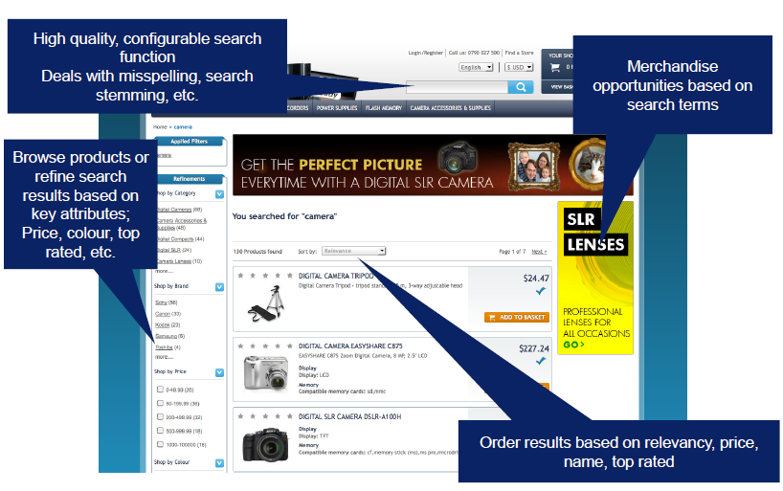
Search and navigation

Slide 17
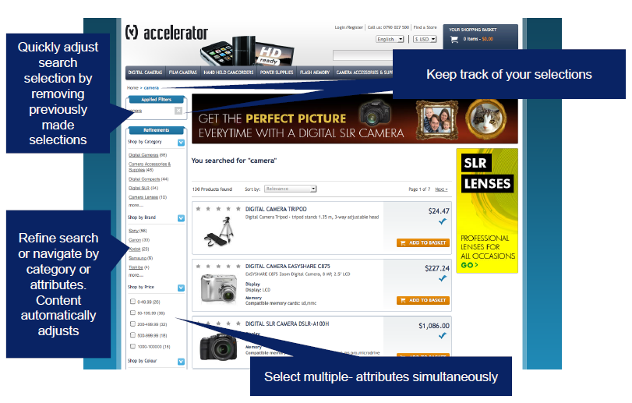
Search results can be refined

Slide 18
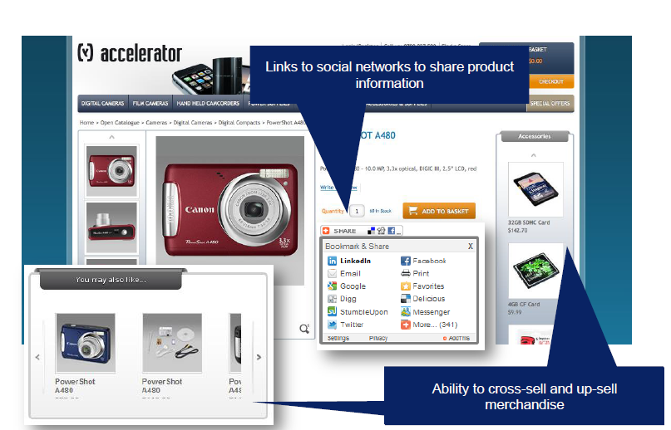
Merchandising

Slide 19
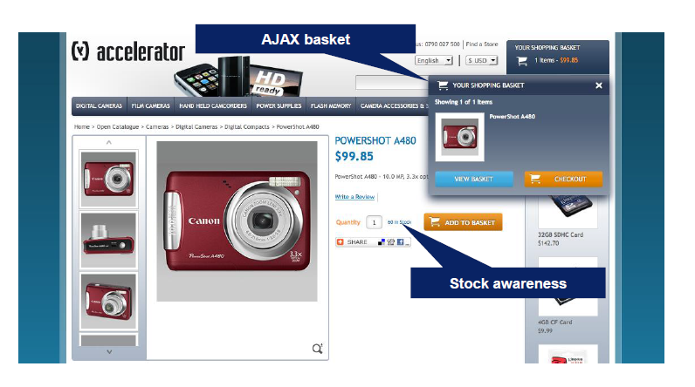
Adding products to basket does not distract from buying process

Slide 20
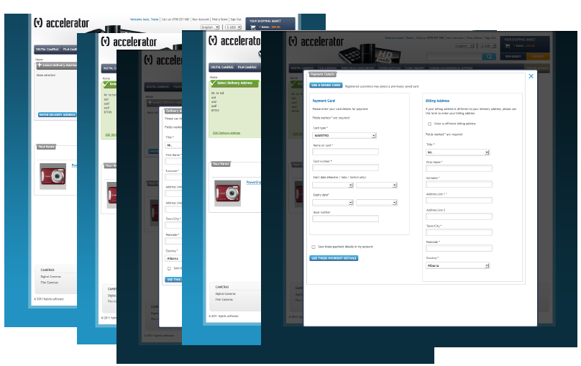
Straightforward checkout process

Slide 21

Email communication can be edited by business users

Slide 22
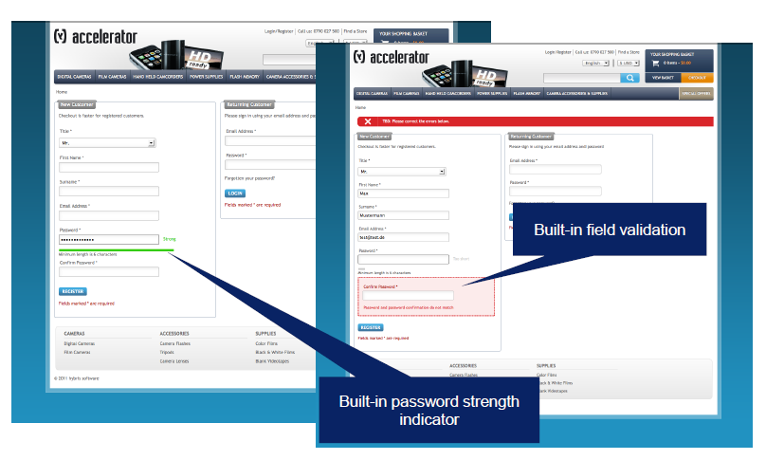
Easy registration for new users

Slide 23
Contents
Overview
Benefits
Features
Future Vision

Slide 24
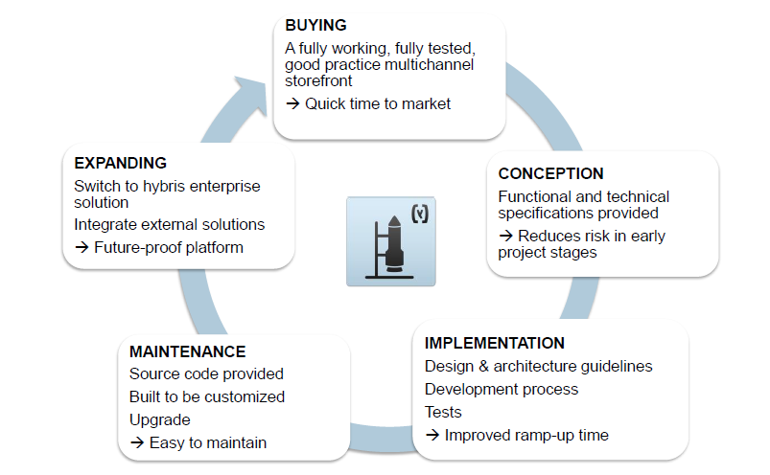
Looking to the Future

Slide 25

Quizees

Slide 26
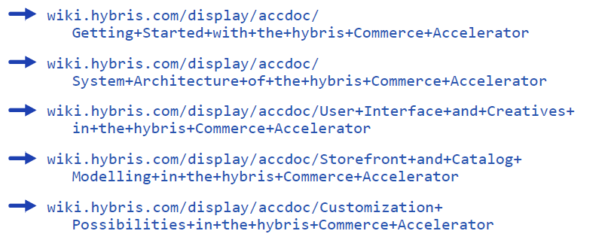
References

